Slide 1
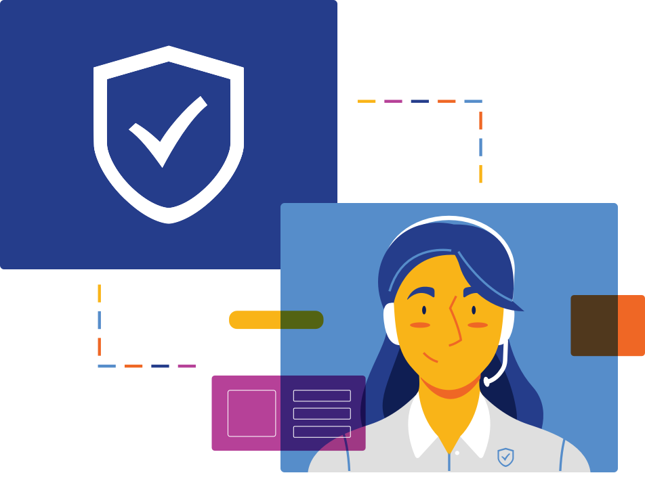

Slide 2
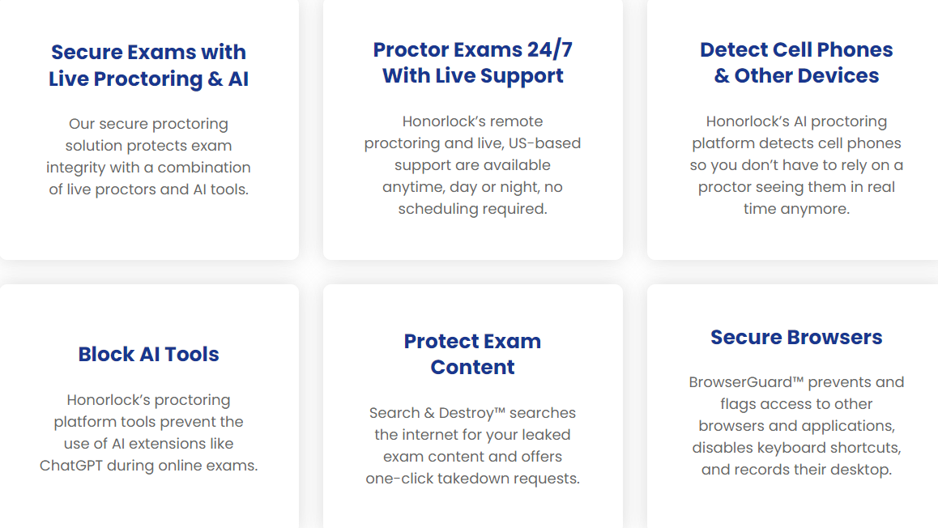
What is Honorlock?
Honorlock vs. Respondus LockDown Browser
Protects Test Integrity by:
Live Proctoring, Enhanced by AI
Finds Leaked Content
Verifies Identity
Speech Detection
Secures Browser & Records Desktop

Slide 3
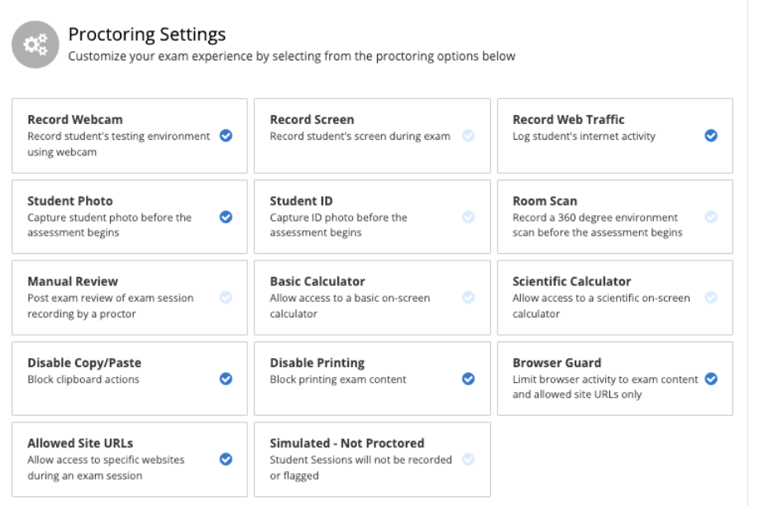
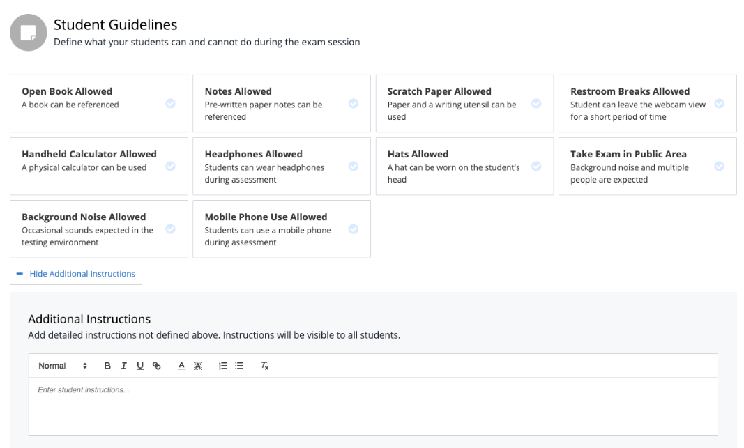

Slide 4
24/7/365 US-based proctoring, Live Chat, and Email Support
No Scheduling required
15 Seconds avg Response time
99% Issue Resolution
7 minutes avg Resolution time

Slide 5
Register for Honorlock training courses Today!
Introduction to Honorlock Proctoring Services
Master Honorlock
Gain expertise in using Honorlock to enhance academic integrity in online exams
Earn 5 Life-Long Credit hrs per course completion

Slide 6
Ways to Contact Us:
Client Services
Help Desk
Phone line: (956) 872-2598
Open a support ticket: Support@southtexascollege.edu
Hector Bazaldua – Course Development Specialist
(956)872-2765
hbazald2@southtexascollege.edu

Slide 7
Questionnaire

